Slide 1
Place your
Logo here

Slide 2
Almost 60% of homes in the U.S. are purchased by people between the ages of 28 & 45, which is within the age group most likely to be expecting access to instant information.
Today’s successful Real Estate Agents are using their tech-obsessed consumer’s lifestyle to their benefit by sharing information directly to the seller or buyer through a mobile device.
Source: Real Estate Information Systems

Slide 3
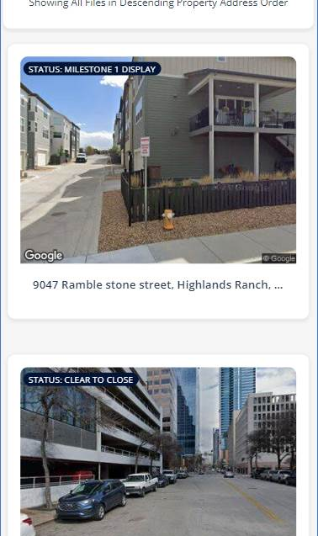
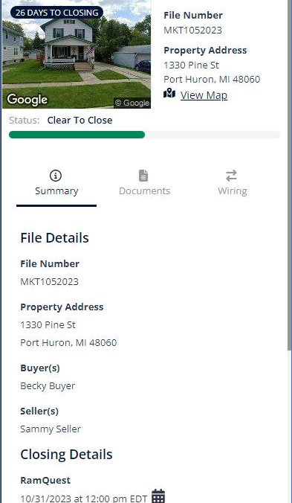
TITLE COMPANY NAME is here to help with ready2close, our mobile-friendly mobile tool!

Slide 4
Visibility & access to all your files on one screen.
Buyers & Sellers only see their property.

Slide 5
Quickly view the property address & Google Street home image. Click the map icon & get driving directions.

Slide 6
Quickly view the property address & Google Street home image. Click the map icon & get driving directions.
See the projected closing date with a glance & add the appointment to any calendar program.

Slide 7
Quickly view the property address & Google Street home image. Click the map icon & get driving directions.
See the projected closing date with a glance & add the appointment to any calendar program.
Check the closing progress.

Slide 8
Quickly view the property address & Google Street home image. Click the map icon & get driving directions.
See the projected closing date with a glance & add the appointment to any calendar program.
Check the closing progress.
View Details shows detailed information about the file as seen on the next slide.
The information shown in this view is customized & differs based on role.

Slide 9
See at-a-glance order progress based on major closing milestones.

Slide 10
See at-a-glance order progress based on major closing milestones.
Buyers & sellers receive email &/or text updates as these important milestones are reached.

Slide 11
See a summary of file details.
The information shown in this view is customized & differs based on role.

Slide 12
See a summary of file details.
Plus critical closing details.
The information shown in this view is customized & differs based on role.

Slide 13
See a summary of file details.
Plus critical closing details.
And, closing team contact details with mobile-friendly clickable links.
The information shown in this view is customized & differs based on role.

Slide 14
Secure document management is easy in this mobile-friendly tool.

Slide 15
Secure document management is easy in this mobile-friendly tool.
Documents on the file can be shared to view, download, or act upon.

Slide 16
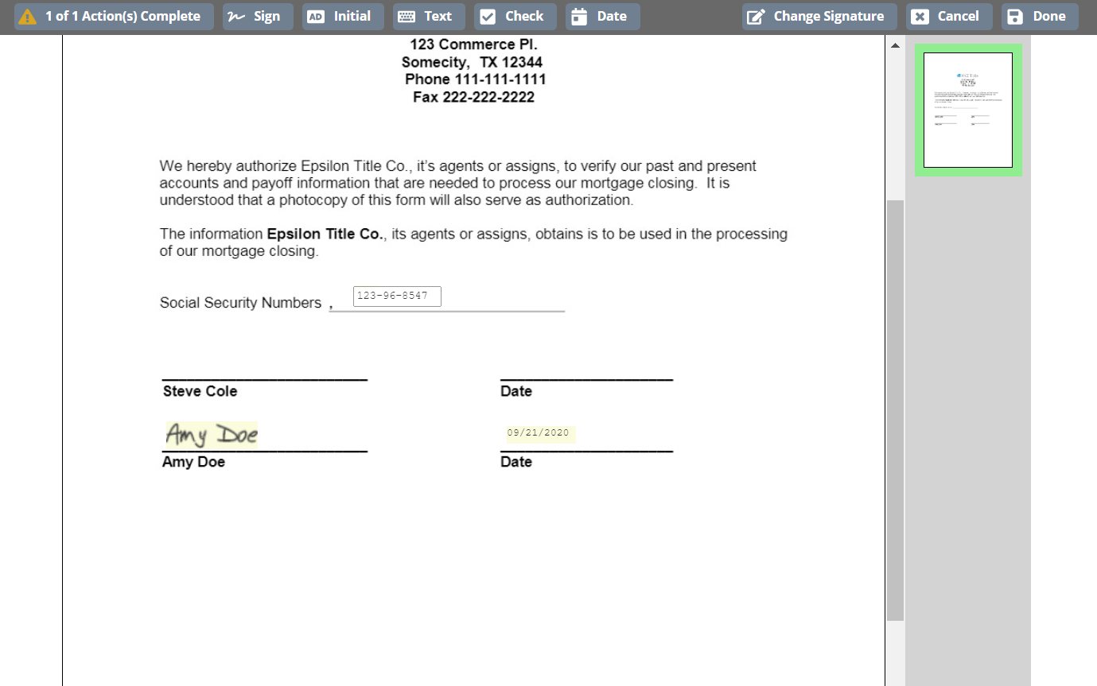
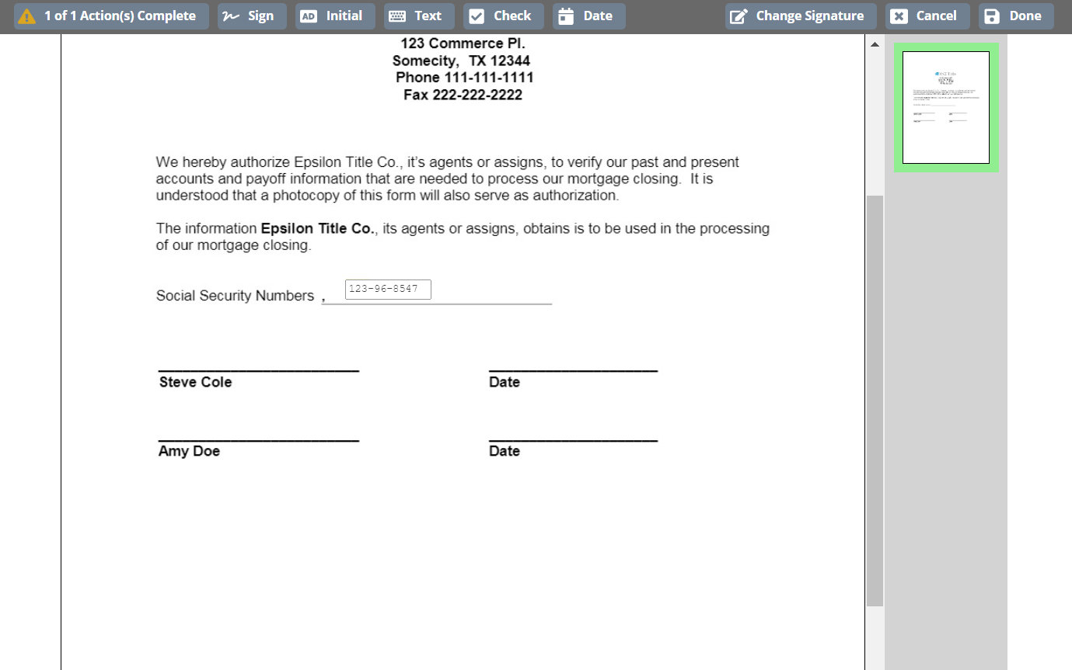
If a non-notarized document requires a signature, it’s quick & easy to eSign here.
Notes:
NOTE: This slide has an animation designed to show how the signature process occurs. You will only need to click one time for the entire sequence to occur.

Slide 17
Consumers can also securely upload documents directly to the title company.

Slide 18
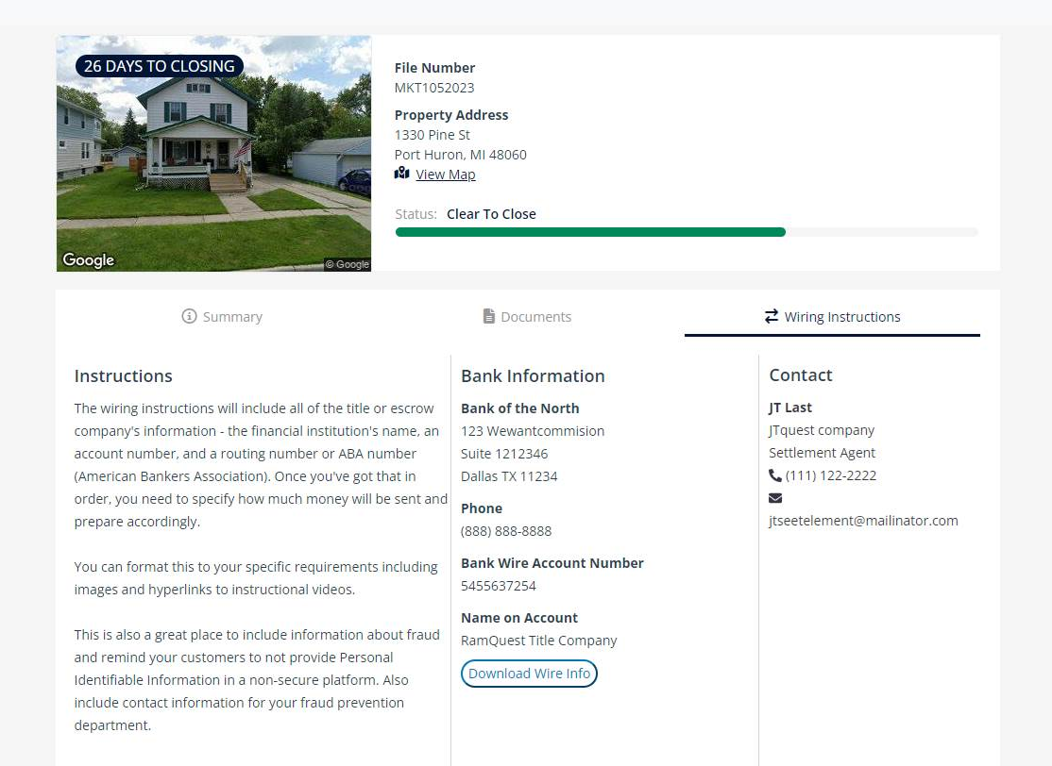
Buyers & Sellers can securely access wiring instructions.

Slide 19
Place your
Logo here
Learn how you can get started with ready2close!

